Slide 1
Communication Technologies 1 (CT1) Machine Learning [Decision Trees]
[Akanchha Choudhary]
Lecture in SS 2019 [10-05-2019]

Slide 2
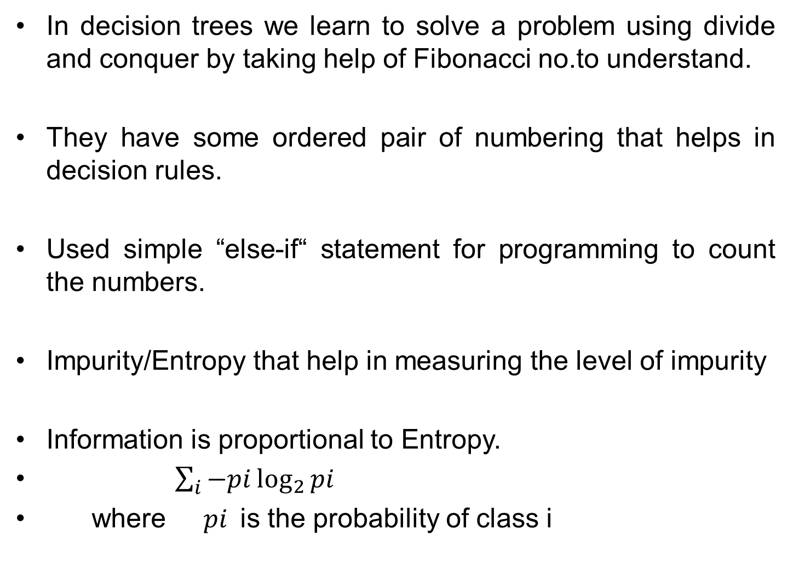
In decision trees we learn to solve a problem using divide and conquer by taking help of Fibonacci no.to understand.
They have some ordered pair of numbering that helps in decision rules.
Used simple “else-if“ statement for programming to count the numbers.
Impurity/Entropy that help in measuring the level of impurity
Information is proportional to Entropy.
$\sum_{i}{−pi\log_{2}{pi}}$
where ${pi }$is the probability of class i

Slide 3
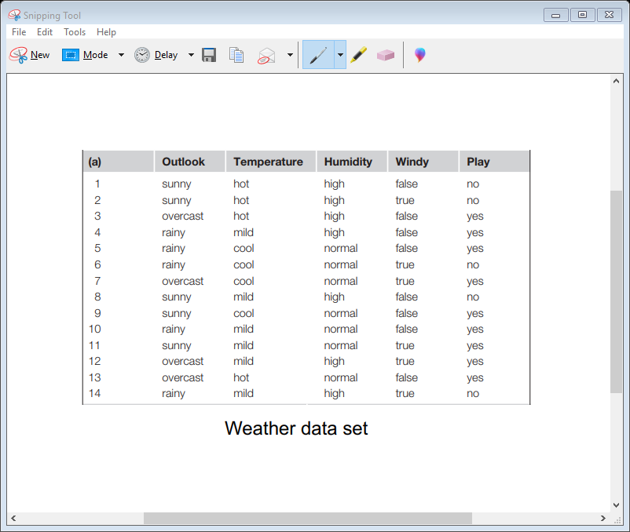
Understanding through the example ;
When we should go to play?
Checked for no.of YES and NO for the weather conditions.
Used information entropy formula and substituted the no.of YES and NO based upon which we made the decision if should play out or not.

